Slide 1
AZERBAIJAN STATE OIL AND INDUSTIRY UNIVERSITY
THE WORLD’S GREATEST TRAVELLERS
FACULTY: ITIF
GROUP:604.20E
TEACHER: YELENA VALIYEVA
STUDENT: GUNEL HUMBATOVA

Slide 2
THE WORLD’S GREATEST TRAVELLERS

Slide 3
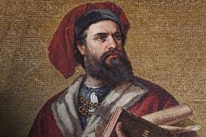
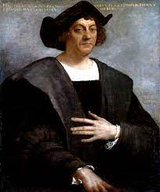
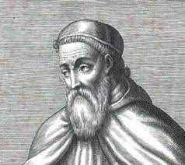
“The world is small, the best way to learn and explore it is by traveling”
Notes:
Today, when we want to travel from one place to another, we can easily do so by plane, train or most probably by a bus. But, do you know that it was not easy to travel distances 5-6 centruires ago. It took a long time to travel on foot, horseback, or through sea. Yet many travellers covered unbelievingly long distances. Let’s begin !

Slide 4
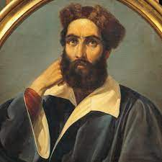
—An Italian merchant Travelled eastward, to Central Asia, Afghanistan, Tibet, and Mongolia.
Marco Polo (1254-1324)
His travels are recorded in The Travels of Marco Polo (also known as Book of the Marvels of the World a book that described to Europeans the then mysterious culture and inner workings of the Eastern world, including the wealth and great size of the Mongol Empire and China in the Yuan Dynasty, giving their first comprehensive look into China, Persia, India, Japan and other Asian cities and countries.
Notes:
Marco Polo was an Italian merchant. He travelled through Central Asia to China using the Silk Route which was in use by a large number of merchants and businessmen.
He travelled eastward, to Central Asia, Afghanistan, Tibet, and Mongolia. It took him three and a half years to reach the capital of China. If we look at the distance from Italy to China that is 5079 miles, today it would hardly take 10 hours, 33 minutes by plane.
Marco dictated his adventures to his fellow prisoner, when he was imprisoned in Europe. This way, the Europeans learnt about the postal service with a series of riders, the use of coal as a fuel, and about paper money in China.

Slide 5
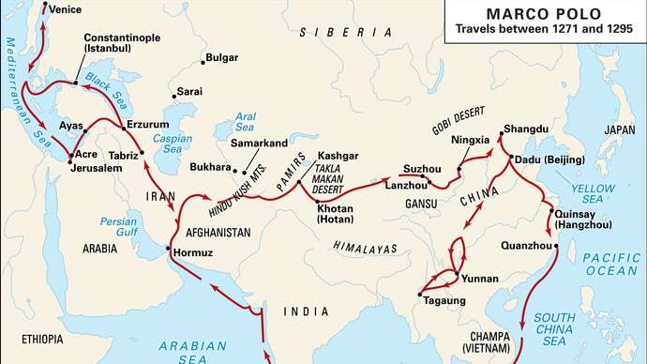

Slide 6
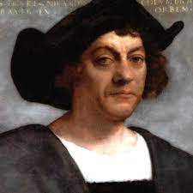
Christopher Columbus (1451-1506)
Christopher Colubmus was an explorer and navigator from Genoa (now part of Italy) who completed four voyages across the Atlantic Ocean, opening the way for the wide-scale European exploration and colonization of the Americas.
Notes:
As a result of Marco Polo’s adventures merchants and explorers tried to find a route to the East by sea, and one of them being Christopher Columbus.
He was an Italian working in Portugal, for his brother who was a mapmaker. Columbus believed that the Earth was round and that he could reach Asia by sailing westward across the Atlantic Ocean.
Columbus

Slide 7
Where did they reach?
A small island in the present Bahamas. As he believed he had reached his destination, these islands were called “West Indies”, a name they have to this day. He actually saw the mainland of South America but believed it was the coast of India!
Notes:
Colubmus died in 1506 and never realized that he had discovered a new continent. He believed that he had discovered a quick route to China and India.

Slide 8
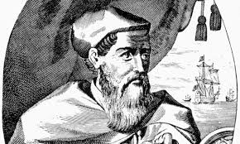
Amerigo Vespucci (1451 – 1512)
Amerigo Vespucci was an Italian-born merchant, explorer, and navigator from the Republic of Florence, from whose name the term “America” is derived.
Notes:
He was an Italian explorer who, at the invitation of the Portuguese king, participated in several Atlantic voyages and sailed along the east coast of South America, between 1499-1502.
Having reached the America continent, Vecpucci may have realized that the lands were not India or China perhaps because the people were totally different lifestyle. The difference in flora, fauna, and people may have convinced him that this was not Asia or India, but a new land mass.

Slide 9
In 1507 Martin Waldseemuller made a world map showing the new continent which he named America after Vespucci’s first name, Amerigo.
In 1508 Vespucci was appointed the chief navigator of Spain. Vespucci died in 1512.

Slide 10
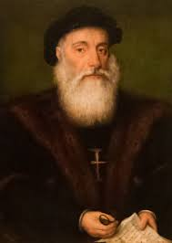
Vasco da Gama (1460-1524)
The other explorer of this period, who was most successful and made an important contribution, was Vasco da Gama.
He died in 1524 in India during a later voyage as the envoy of the Portuguese king.
Notes:
He was a Portuguese sailor, who ventured to find the sea route to the East.
When he reached Kenya, he was guided to India by an Arab sailor. He reached Malabar Coast in India.

Slide 11
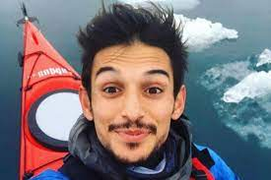
From nowadays, I would like to tell you about Turkish traveler Emre Durmuş. Youtube.com – Emre Durmuş
Notes:
He is only 22 years old. He set out on this road by leaving his school, family, future concerns, friends behind and selling his household items. France, India, Iran, Netherlands, Bali, Sri Lanka, Morocco, Georgia, Russia and many more cities. The surprising thing is that he travels free of charge.

Slide 12
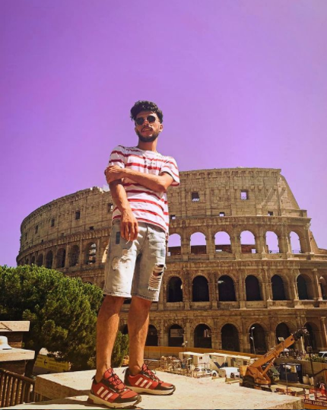
Another traveler is Azerbaijani - Najmaddin Aslanli.
If you are looking for cheap ways to travel, you can visit his channel.
Youtube.com – Najmaddin traveller

Slide 13


RECOURCES:
https://en.wikipedia.org/wiki/Marco_Polo
https://www.slideshare.net/AlifyaNaeem/world-travellers-52631181
https://en.wikipedia.org/wiki/Amerigo_Vespucci
https://en.wikipedia.org/wiki/Christopher_Columbus
https://en.wikipedia.org/wiki/Vasco_da_Gama

Slide 14
Thank you !

